Slide 1
The ultimate form of asynchronization - coroutine
Sdcb@2016

Slide 2

inspiration by…
http://www.codejie.net/love/index.html

Slide 3
Any ideas?
Synchronous (Thread.Sleep)
Awaitable Timer
setTimeout/setInterval
Promise
async/await

Slide 4
Synchronous (Thread.Sleep)
var str = "两个黄鹂鸣翠柳，\r\n一行白鹭上青天。";
uiTextBox.Text = "";
foreach (var ch in str)
{
uiTextBox.Text += ch;
Thread.Sleep(200);
}
Update();

Slide 5
How about Javascript?
Javscript is a asynchronous friendly language
setTimeout/setInterval is not Synchronous
It’s not very easy to write clean beautiful code with asynchronous.

Slide 6
Try in Javascript (Busy waiting)
function sleep(delay) {
var start = new Date().getTime();
while (new Date().getTime() < start + delay);
}
This is an incredibly bad idea. Please for goodness sake do not use this code.
That wastes battery, and blocks JS from executing in the whole page. A very bad idea.
http://stackoverflow.com/questions/1141302/is-there-a-sleep-function-in-javascript/1141340

Slide 7
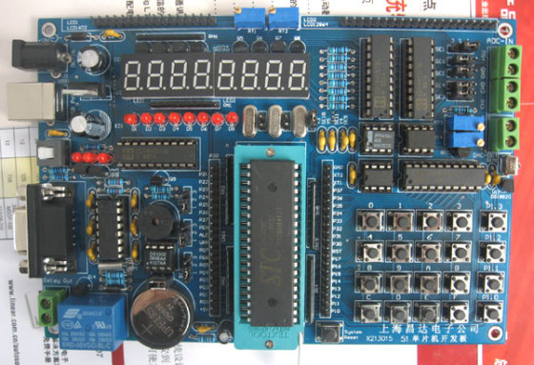
My SCM – AT89C51
Fully Static Operation: 0 Hz to 24 MHz
4K Bytes of In-System Reprogrammable Flash Memory
128 x 8-bit Internal RAM
Two 16-bit Timer/Counters
32 Programmable I/O Lines
Six Interrupt Sources

Slide 8
My SCM (Music Box)
Keyboard scan
LED Segment Displays scan
LED Light scan
Buzzer scan
COM communication with PC
At same time!

Slide 9
My SCM (Work at Sleep)
Maybe the first multi-task thought ever in the history
void Sleep(uint16 ticks)
{
if (ticks > 11)
{
ticks -= 11;
KeyboardInterrupt();
}
while (ticks--);
}

Slide 10
Try in Javascript (Trivial setTimeout)
function showTextIn(ui, text, allTime) {
ui.textContent = "";
for (let i = 0; i < text.length; ++i) {
setTimeout(function () {
ui.textContent += text[i];
}, allTime / text.length * i);
}
}

Slide 11
Try in Javascript (Promise)
function showTextIn(ui, text, allTime) {
ui.textContent = "";
return forEachAsync(text, function (char) {
ui.textContent += char;
return delayAsync(allTime / text.length);
});
}

Slide 12
Callback vs Promise
Forget about Callback
Callback hell →.then
Error check everywhere →.catch/.finally
Multiple callback dispatch function → multiple .then
Non-callback null check → don’t care
Wait multiple callback → $.when
Just use Promise!

Slide 13
Promise library/language support
Javascript libraries:
JQueryDefered<T>
AngularJS [“$q”]
ES 2015 (Chrome 32, Microsoft Edge, FF 29, Opera 19, Safari 7.1)
C# 4.0 Task<T>
ContinueWith instead of then
Can specify execution context
C++ boost::future<T>
And more…

Slide 14
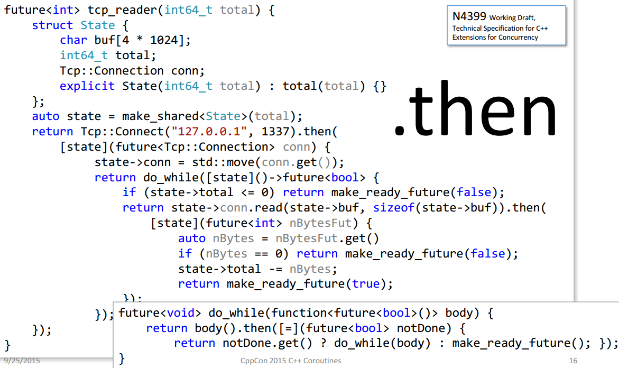
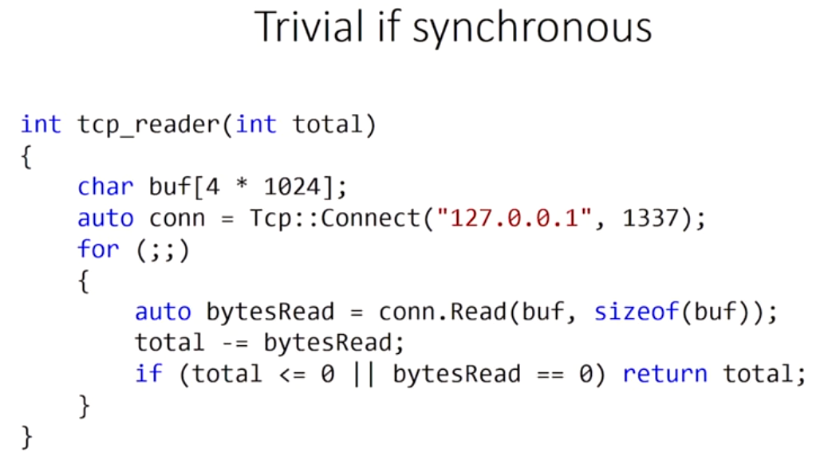
Promise in complex scenario
CppCon 2015- Gor Nishanov

Slide 15
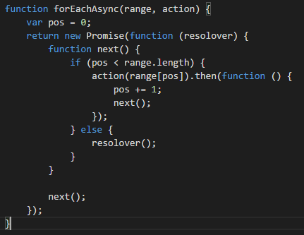
Promise is nice, but…
Represent while/for loop is hard to understand
Try promise something is not easy
Hard to create a promise
Not abstract enough

Slide 16
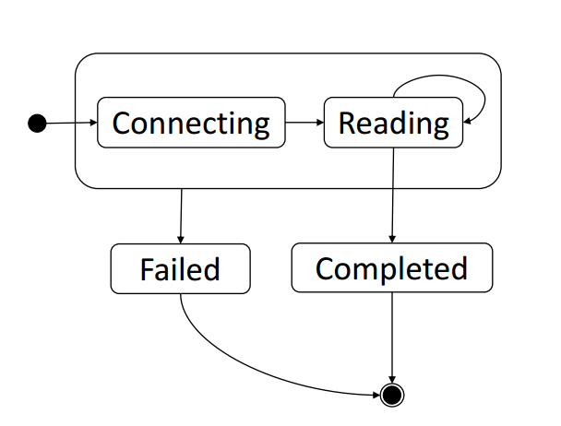
Coroutine: Async state machine

Slide 17
Keyword yield (C# 2.0)
IEnumerable Power(int number, int exponent)
{
int counter = 0;
int result = 1;
while (counter++ < exponent)
{
result = result * number;
yield return result;
}
}

Slide 18
Keyword yield (C# 2.0)
View Debugging Demo (yield.gif)
Benefits:
Saves memory
Reduce Calculate Times
Better abstraction of generator
Usage:
LINQ(C# 3.0)
Lodash(Javascript)

Slide 19
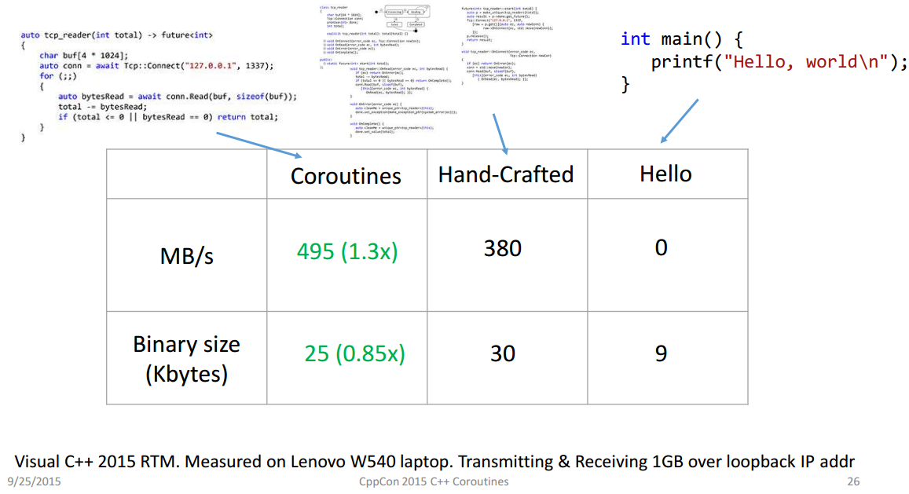
What about perf?

Slide 20
Keyword async await (C# 5.0)
async void button1_Click(object sender, EventArgs e)
{
var str = "两个黄鹂鸣翠柳，\r\n一行白鹭上青天。";
uiTextBox.Text = "";
foreach (var ch in str)
{
uiTextBox.Text += ch;
// Thread.Sleep(200);
// Update();
await Task.Delay(200);
}
}

Slide 21
setTimeout think again(Async state machine)
function showTextIn(ui, text, allTime) {
let state = { pos: 0 };
ui.textContent = "";
function next() {
if (state.pos < text.length) {
ui.textContent += text[state.pos];
state.pos += 1;
setTimeout(next, allTime / text.length);
}
}
next();
}

Slide 22
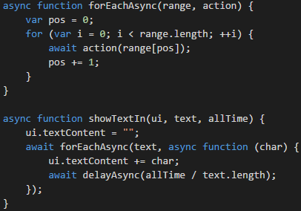
Coroutine in Javascript
ES 2015: generator function
ES 7 proposal: async await
babel: transform to ES5
Typescript 1.7: compile to ES6
Typescript 2.0: compile to ES5

Slide 23
Coroutine language support
Language | Generator Function | Async/Await
C# | 2.0 | 5.0
Javascript | ES 2015 | ES 7 Proposal
C++ | C++ 17 Proposal | C++ 17 Proposal
PHP | 5.5 | HHVM
Python | 2.2 | 3.5
Java | Not Supported | Not Supported

Slide 24
Reference sources
https://www.youtube.com/watch?v=_fu0gx-xseY
http://cn.made-in-china.com/tupian/anypcb-ebKnWPBvhfRT.html
http://www.atmel.com/images/doc0265.pdf
https://developer.mozilla.org/zh-CN/docs/Web/JavaScript/Reference/Global_Objects/Promise
https://msdn.microsoft.com/zh-cn/library/9k7k7cf0(v=vs.80).aspx
http://www.cockos.com/licecap/
http://www.phy.mtu.edu/~suits/notefreqs.html

Slide 25
Questions?

